Slide 1

Operating Systems
BCSC 0004
CPU Scheduling
Priority Scheduling

Slide 2
Priority Based Scheduling
Priority scheduling is a non-preemptive / Preemptive CPU Scheduling algorithm and one of the most common scheduling algorithms in batch systems.
Each process is assigned a priority. Process with highest priority is to be executed first and so on.
Processes with same priority are executed on first come first served basis.
Priority can be decided based on memory requirements, time requirements or any other resource requirement.

Slide 3
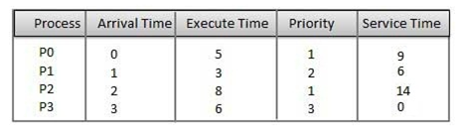

Slide 4







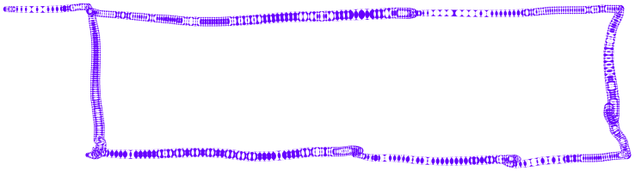







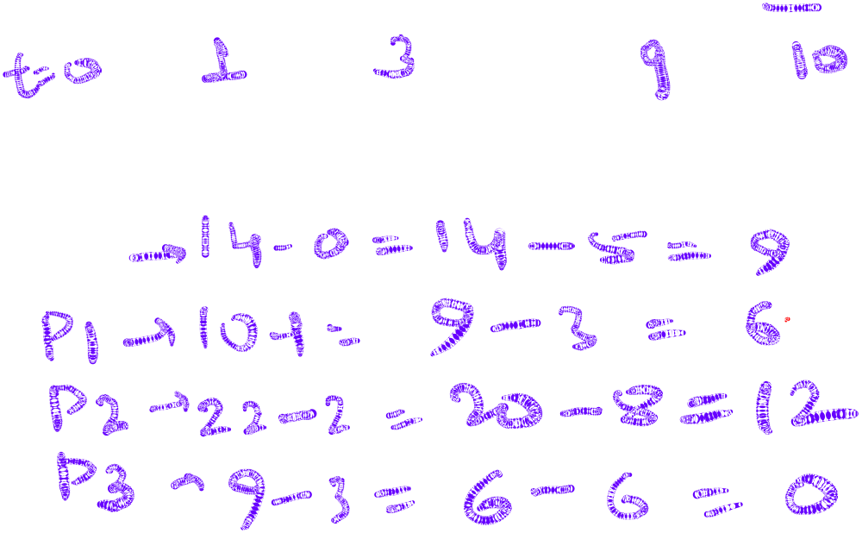



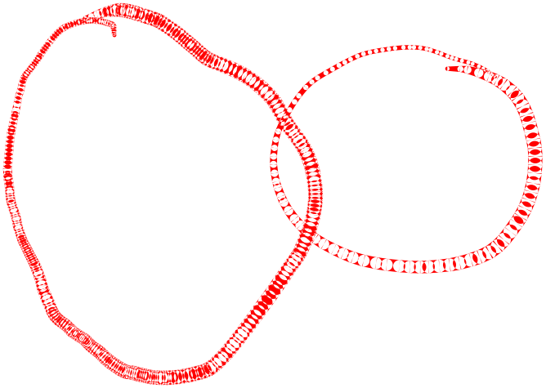




Slide 5





















PROCESS | ARRIVAL TIME | BURST TIME | PRIORITY
P1 | 0 | 8 | 3
P2 | 1 | 5 | 2
P3 | 2 | 2 | 1
P4 | 6 | 4 | 0

Slide 6
PROCESS | ARRIVAL TIME | BURST TIME | PRIORITY
P1 | 0 | 8 | 3
P2 | 1 | 5 | 2
P3 | 2 | 2 | 1
P4 | 6 | 4 | 0

Slide 7
































PROCESS | BURST TIME | PRIORITY
P1 | 8 | 3
P2 | 5 | 2
P3 | 2 | 1
P4 | 4 | 0

Slide 8
PROCESS | BURST TIME | PRIORITY
P1 | 8 | 3
P2 | 5 | 2
P3 | 2 | 1
P4 | 4 | 0

Slide 9
PROCESS | BURST TIME | PRIORITY
P1 | 8 | 3
P2 | 5 | 2
P3 | 2 | 1
P4 | 4 | 0

Slide 10
PROCESS | ARRIVAL TIME | BURST TIME | PRIORITY
P1 | 0 | 8 | 3
P2 | 1 | 5 | 2
P3 | 2 | 2 | 1
P4 | 6 | 4 | 0

Slide 11















Slide 12
Starvation and Aging
Starvation or indefinite blocking is phenomenon associated with the Priority scheduling algorithms, in which a process ready to run for CPU can wait indefinitely because of low priority. In heavily loaded computer system, a steady stream of higher-priority processes can prevent a low-priority process from ever getting the CPU.
Aging : Solution for increasing the time bound priority of processes.

Slide 13


